Slide 1
Software Engineering: A Practitioner’s Approach, 6/eChapter 8 Analysis Modelingcopyright © 1996, 2001, 2005R.S. Pressman & Associates, Inc.For University Use OnlyMay be reproduced ONLY for student use at the university level when used in conjunction with Software Engineering: A Practitioner's Approach.Any other reproduction or use is expressly prohibited.

Slide 2
Requirements Analysis
Requirements analysis
specifies software’s operational characteristics
indicates software's interface with other system elements
establishes constraints that software must meet
Requirements analysis allows the software engineer (called an analyst or modeler in this role) to:
elaborate on basic requirements established during earlier requirement engineering tasks
build models that depict user scenarios, functional activities, problem classes and their relationships, system and class behavior, and the flow of data as it is transformed.

Slide 3
A Bridge

Slide 4
Rules of Thumb
The model should focus on requirements that are visible within the problem or business domain. The level of abstraction should be relatively high.
Each element of the analysis model should add to an overall understanding of software requirements and provide insight into the information domain, function and behavior of the system.
Delay consideration of infrastructure and other non-functional models until design.
Minimize coupling throughout the system.
Be certain that the analysis model provides value to all stakeholders.
Keep the model as simple as it can be.

Slide 5
Domain Analysis
Software domain analysis is the identification, analysis, and specification of common requirements from a specific application domain, typically for reuse on multiple projects within that application domain . . . [Object-oriented domain analysis is] the identification, analysis, and specification of common, reusable capabilities within a specific application domain, in terms of common objects, classes, subassemblies, and frameworks . . .
Donald Firesmith

Slide 6
Domain Analysis
Define the domain to be investigated.
Collect a representative sample of applications in the domain.
Analyze each application in the sample.
Develop an analysis model for the objects.

Slide 7
Data Modeling
examines data objects independently of processing
focuses attention on the data domain
creates a model at the customer’s level of abstraction
indicates how data objects relate to one another

Slide 8
What is a Data Object?
Object
—something that is described by a set
of attributes (data items) and that will be
manipulated within the software (system)
each
instance
of an object (e.g., a book)
can be identified uniquely (e.g., ISBN #)
each plays a necessary role in the system
i.e., the system could not function without
access to instances of the object
each is described by attributes that are
themselves data items

Slide 9
Typical Objects
external entities (printer, user, sensor)
things
(e.g, reports, displays, signals)
occurrences or events (e.g., interrupt, alarm)
roles
(e.g., manager, engineer, salesperson)
organizational units
(e.g., division, team)
places
(e.g., manufacturing floor)
structures (e.g., employee record)

Slide 10
Data Objects and Attributes
A data object contains a set of attributes that act as an aspect, quality, characteristic, or descriptor of the object
object: automobile
attributes:
make
model
body type
price
options code

Slide 11
What is a Relationship?
relationship
—indicates “connectedness”;
a "fact" that must be "remembered"
by the system and cannot or is not computed
or derived mechanically
several instances of a relationship can exist
objects can be related in many different ways

Slide 12
ERD Notation
One common form:
(0, m)
object
relationship
object
1
(1, 1)
2
attribute
Another common form:
object
relationship
object
1
2
(0, m)
(1, 1)

Slide 13
Building an ERD
Level 1—model all data objects (entities) and their “connections” to one another
Level 2—model all entities and relationships
Level 3—model all entities, relationships, and the attributes that provide further depth

Slide 14
The ERD: An Example
request
for service
Customer
places
(1,1)
(1,m)
(1,1)
standard
task table
generates
(1,n)
work
order
(1,1)
(1,1)
(1,1)
selected
from
work
tasks
(1,w)
consists
of
(1,w)
(1,i)
materials
lists

Slide 15
Object-Oriented Concepts
Must be understood to apply class-based elements of the analysis model
Key concepts:
Classes and objects
Attributes and operations
Encapsulation and instantiation
Inheritance

Slide 16
Classes
object-oriented thinking begins with the definition of a class, often defined as:
template
generalized description
“blueprint” ... describing a collection of similar items
a metaclass (also called a superclass) establishes a hierarchy of classes
once a class of items is defined, a specific instance of the class can be identified

Slide 17
Building a Class

Slide 18
What is a Class?
occurrences
roles
things
organizational units
places
external entities
structures
class name
attributes:
operations:

Slide 19
Encapsulation/Hiding
The object encapsulates
both data and the logical
procedures required to
manipulate the data
method
# 1
method
# 2
data
method
# 3
method
# 6
method
# 5
method
# 4
Achieves “information hiding”

Slide 20
Class Hierarchy
PieceOfFurniture (superclass)
Table
Chair
Desk
”Chable"
subclasses of the
instances of Chair

Slide 21
Methods (a.k.a. Operations, Services)
An executable procedure that is encapsulated in a class and is designed to operate on one or more data attributes that are defined as part of the class.
A method is invoked
via message passing.

Slide 22
Scenario-Based Modeling
“[Use-cases] are simply an aid to defining what exists outside the system (actors) and what should be performed by the system (use-cases).” Ivar Jacobson
(1) What should we write about?
(2) How much should we write about it?
(3) How detailed should we make our description?
(4) How should we organize the description?

Slide 23
Use-Cases
a scenario that describes a “thread of usage” for a system
actors represent roles people or devices play as the system functions
users can play a number of different roles for a given scenario

Slide 24
Developing a Use-Case
What are the main tasks or functions that are performed by the actor?
What system information will the the actor acquire, produce or change?
Will the actor have to inform the system about changes in the external environment?
What information does the actor desire from the system?
Does the actor wish to be informed about unexpected changes?

Slide 25
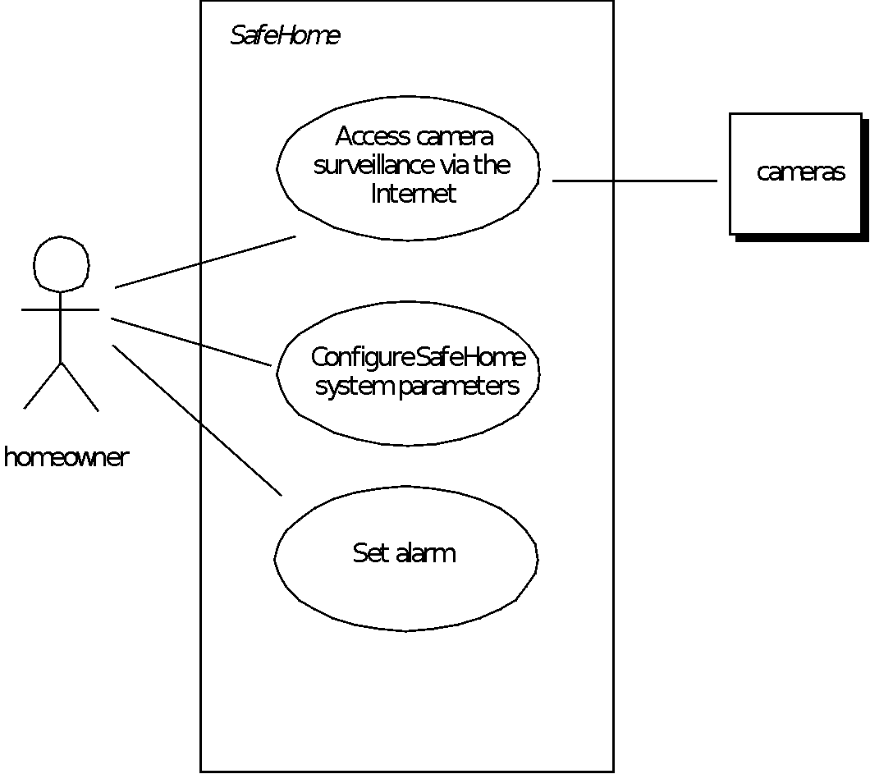
Use-Case Diagram

Slide 26
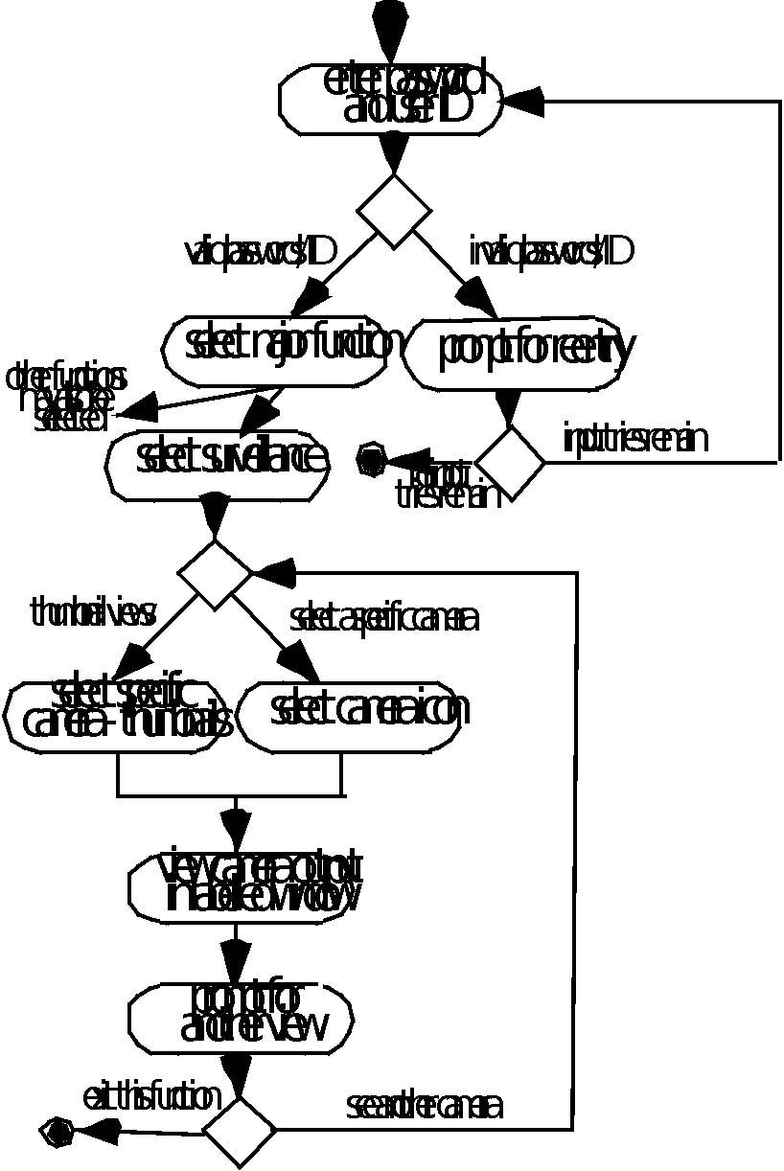
Activity Diagram
Supplements the use-case by providing a diagrammatic representation of procedural flow

Slide 27
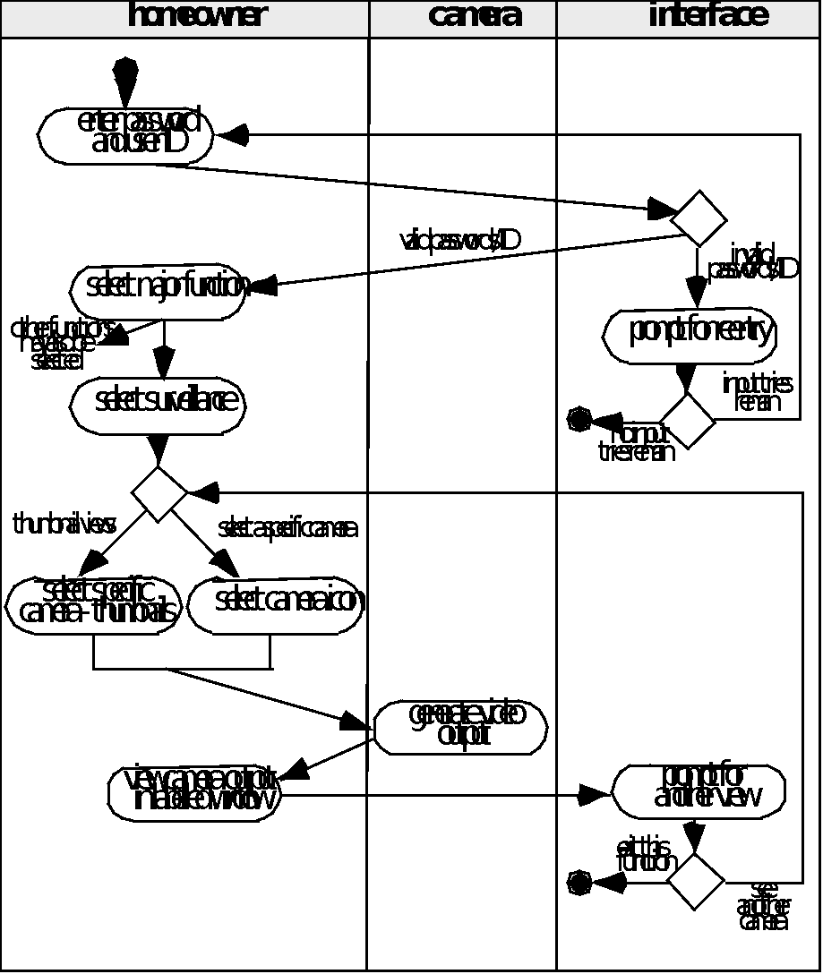
Swimlane Diagrams
Allows the modeler to represent the flow of activities described by the use-case and at the same time indicate which actor (if there are multiple actors involved in a specific use-case) or analysis class has responsibility for the action described by an activity rectangle

Slide 28
Flow-Oriented Modeling
Represents how data objects are transformed at they move through the system
A data flow diagram (DFD) is the diagrammatic form that is used
Considered by many to be an ‘old school’ approach, flow-oriented modeling continues to provide a view of the system that is unique—it should be used to supplement other analysis model elements

Slide 29
The Flow Model
Every computer-based system is an
information transform ....
computer
based
system
input
output

Slide 30
Flow Modeling Notation
external entity
process
data flow
data store

Slide 31
External Entity
A producer or consumer of data
Examples: a person, a device, a sensor
Another example: computer-based
system
Data must always originate somewhere
and must always be sent to something

Slide 32
Process
A data transformer (changes input
to output)
Examples: compute taxes, determine area,
format report, display graph
Data must always be processed in some
way to achieve system function

Slide 33
Data Flow
Data flows through a system, beginning
as input and be transformed into output.
base
compute
triangle
area
area
height

Slide 34
Data Stores
Data is often stored for later use.
sensor #
sensor #, type,
location, age
look-up
sensor
data
report required
type,
location, age
sensor number
sensor data

Slide 35
Data Flow Diagramming: Guidelines
all icons must be labeled with meaningful names
the DFD evolves through a number of levels of detail
always begin with a context level diagram (also called level 0)
always show external entities at level 0
always label data flow arrows
do not represent procedural logic

Slide 36
Constructing a DFD—I
review the data model to isolate data objects and use a grammatical parse to determine “operations”
determine external entities (producers and consumers of data)
create a level 0 DFD

Slide 37
Level 0 DFD Example
processing
request
user
requested
video
signal
digital
video
processor
monitor
video
source
NTSC
video signal

Slide 38
Constructing a DFD—II
write a narrative describing the transform
parse to determine next level transforms
“balance” the flow to maintain data flow continuity
develop a level 1 DFD
use a 1:5 (approx.) expansion ratio

Slide 39
The Data Flow Hierarchy
a
b
x
P
y
level 0
a
c
p2
f
p1
p4
b
d
5
p3
e
g
level 1

Slide 40
Flow Modeling Notes
each bubble is refined until it does just one thing
the expansion ratio decreases as the number of levels increase
most systems require between 3 and 7 levels for an adequate flow model
a single data flow item (arrow) may be expanded as levels increase (data dictionary provides information)

Slide 41
Process Specification (PSPEC)
bubble
PSPEC
narrative
pseudocode (PDL)
equations
tables
diagrams and/or charts

Slide 42
DFDs: A Look Ahead
analysis model
Maps into
design model

Slide 43
Control Flow Diagrams
Represents “events” and the processes that manage events
An “event” is a Boolean condition that can be ascertained by:
listing all sensors that are "read" by the software.
listing all interrupt conditions.
listing all "switches" that are actuated by an operator.
listing all data conditions.
recalling the noun/verb parse that was applied to the processing narrative, review all "control items" as possible CSPEC inputs/outputs.

Slide 44
The Control Model
the control flow diagram is "superimposed" on the DFD
and shows events that control the processes noted in
the DFD
control flows—events and control items—are noted by
dashed arrows
a vertical bar implies an input to or output from a control
spec (CSPEC) — a separate specification that
describes how control is handled
a dashed arrow entering a vertical bar is an input to the
CSPEC
a dashed arrow leaving a process implies a data
condition
a dashed arrow entering a process implies a control
input read directly by the process
control flows do not physically activate/deactivate the
processes—this is done via the CSPEC

Slide 45
Control Flow Diagram
beeper on/off
copies done
full
manage
copying
read
operator
input
start
problem light
reload
process
empty
create
user
displays
perform
problem
diagnosis
jammed
display panel enabled

Slide 46
Control Specification (CSPEC)
The CSPEC can be:
state diagram
(sequential spec)
state transition table
combinatorial spec
decision tables
activation tables

Slide 47
Guidelines for Building a CSPEC
list all sensors that are "read" by the software
list all interrupt conditions
list all "switches" that are actuated by the operator
list all data conditions
recalling the noun-verb parse that was applied to the
software statement of scope, review all "control items"
as possible CSPEC inputs/outputs
describe the behavior of a system by identifying its
states; identify how each state is reach and defines
the transitions between states
focus on possible omissions ... a very common error in
specifying control, e.g., ask: "Is there any other way I
can get to this state or exit from it?"

Slide 48
Class-Based Modeling
Identify analysis classes by examining the problem statement
Use a “grammatical parse” to isolate potential classes
Identify the attributes of each class
Identify operations that manipulate the attributes

Slide 49
Analysis Classes
External entities (e.g., other systems, devices, people) that produce or consume information to be used by a computer-based system.
Things (e.g, reports, displays, letters, signals) that are part of the information domain for the problem.
Occurrences or events (e.g., a property transfer or the completion of a series of robot movements) that occur within the context of system operation.
Roles (e.g., manager, engineer, salesperson) played by people who interact with the system.
Organizational units (e.g., division, group, team) that are relevant to an application.
Places (e.g., manufacturing floor or loading dock) that establish the context of the problem and the overall function of the system.
Structures (e.g., sensors, four-wheeled vehicles, or computers) that define a class of objects or related classes of objects.

Slide 50
Selecting Classes—Criteria
retained information
needed services
multiple attributes
common attributes
common operations
essential requirements

Slide 51
Class Diagram
Class name
attributes
operations

Slide 52
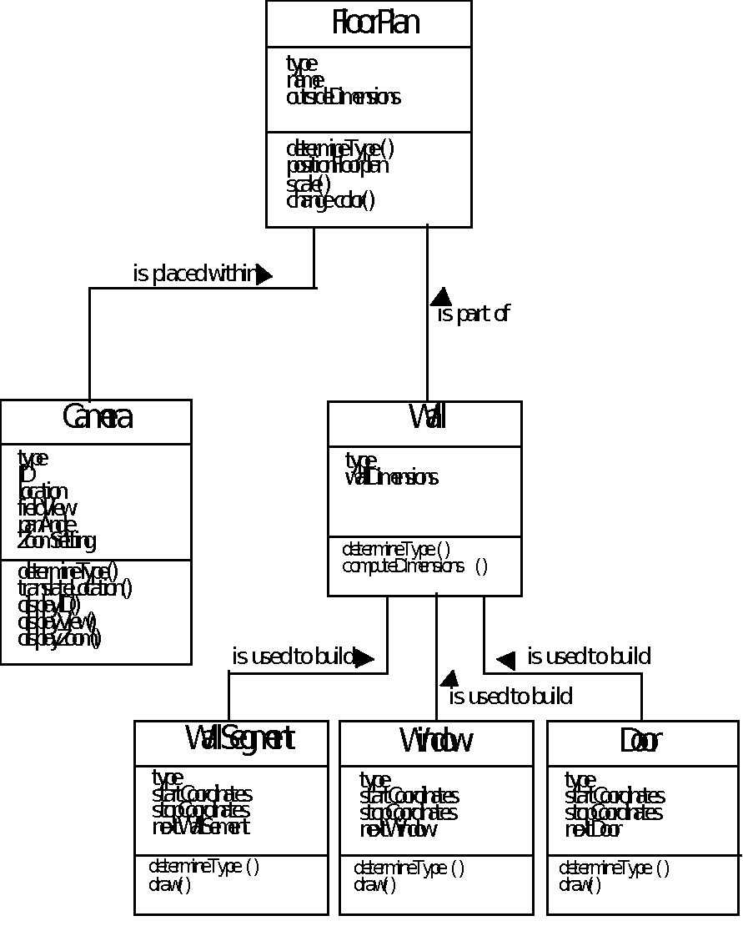
Class Diagram

Slide 53
CRC Modeling
Analysis classes have “responsibilities”
Responsibilities are the attributes and operations encapsulated by the class
Analysis classes collaborate with one another
Collaborators are those classes that are required to provide a class with the information needed to complete a responsibility.
In general, a collaboration implies either a request for information or a request for some action.

Slide 54
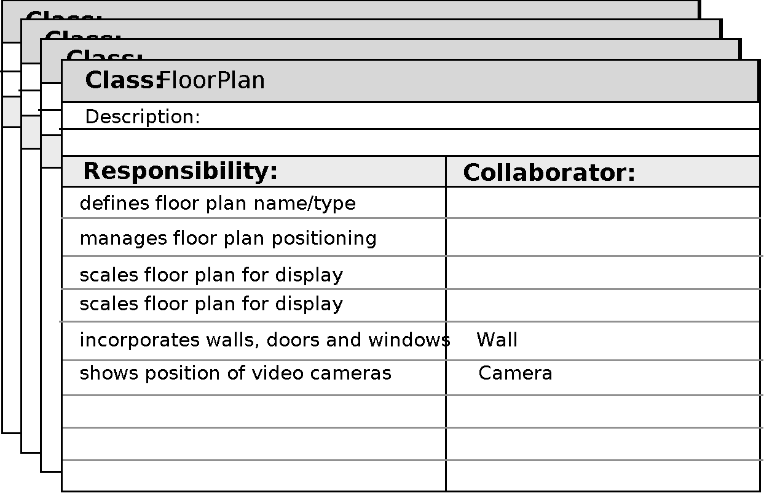
CRC Modeling

Slide 55
Class Types
Entity classes, also called model or business classes, are extracted directly from the statement of the problem (e.g., FloorPlan and Sensor).
Boundary classes are used to create the interface (e.g., interactive screen or printed reports) that the user sees and interacts with as the software is used.
Controller classes manage a “unit of work” [UML03] from start to finish. That is, controller classes can be designed to manage
the creation or update of entity objects;
the instantiation of boundary objects as they obtain information from entity objects;
complex communication between sets of objects;
validation of data communicated between objects or between the user and the application.

Slide 56
Responsibilities
System intelligence should be distributed across classes to best address the needs of the problem
Each responsibility should be stated as generally as possible
Information and the behavior related to it should reside within the same class
Information about one thing should be localized with a single class, not distributed across multiple classes.
Responsibilities should be shared among related classes, when appropriate.

Slide 57
Collaborations
Classes fulfill their responsibilities in one of two ways:
A class can use its own operations to manipulate its own attributes, thereby fulfilling a particular responsibility, or
a class can collaborate with other classes.
Collaborations identify relationships between classes
Collaborations are identified by determining whether a class can fulfill each responsibility itself
three different generic relationships between classes [WIR90]:
the is-part-of relationship
the has-knowledge-of relationship
the depends-upon relationship

Slide 58
Composite Aggregate Class

Slide 59
Reviewing the CRC Model
All participants in the review (of the CRC model) are given a subset of the CRC model index cards.
Cards that collaborate should be separated (i.e., no reviewer should have two cards that collaborate).
All use-case scenarios (and corresponding use-case diagrams) should be organized into categories.
The review leader reads the use-case deliberately.
As the review leader comes to a named object, she passes a token to the person holding the corresponding class index card.
When the token is passed, the holder of the class card is asked to describe the responsibilities noted on the card.
The group determines whether one (or more) of the responsibilities satisfies the use-case requirement.
If the responsibilities and collaborations noted on the index cards cannot accommodate the use-case, modifications are made to the cards.
This may include the definition of new classes (and corresponding CRC index cards) or the specification of new or revised responsibilities or collaborations on existing cards.

Slide 60
Associations and Dependencies
Two analysis classes are often related to one another in some fashion
In UML these relationships are called associations
Associations can be refined by indicating multiplicity (the term cardinality is used in data modeling
In many instances, a client-server relationship exists between two analysis classes.
In such cases, a client-class depends on the server-class in some way and a dependency relationship is established

Slide 61
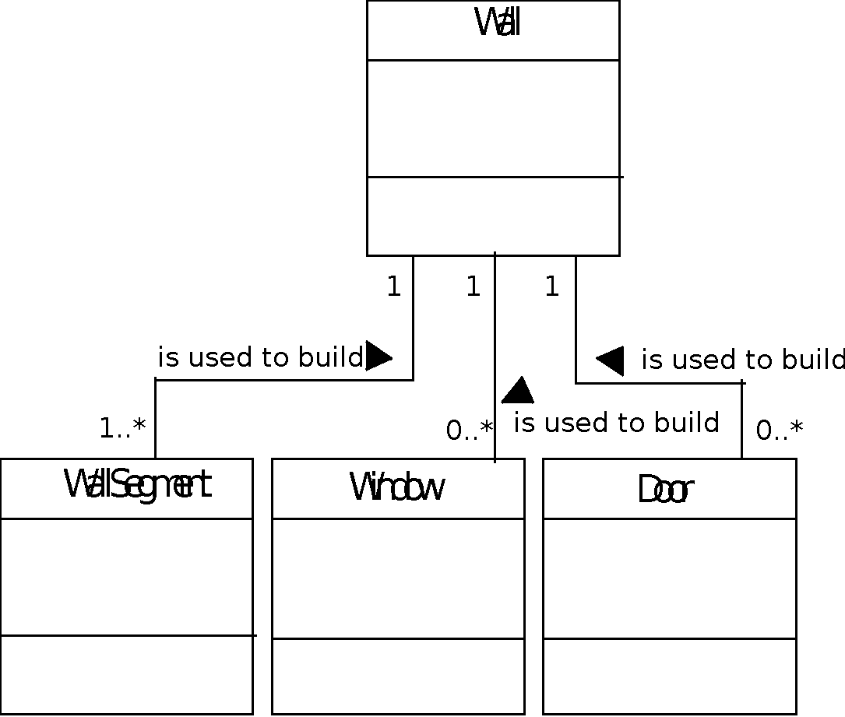
Multiplicity

Slide 62
Dependencies

Slide 63
Analysis Packages
Various elements of the analysis model (e.g., use-cases, analysis classes) are categorized in a manner that packages them as a grouping
The plus sign preceding the analysis class name in each package indicates that the classes have public visibility and are therefore accessible from other packages.
Other symbols can precede an element within a package. A minus sign indicates that an element is hidden from all other packages and a # symbol indicates that an element is accessible only to packages contained within a given package.

Slide 64
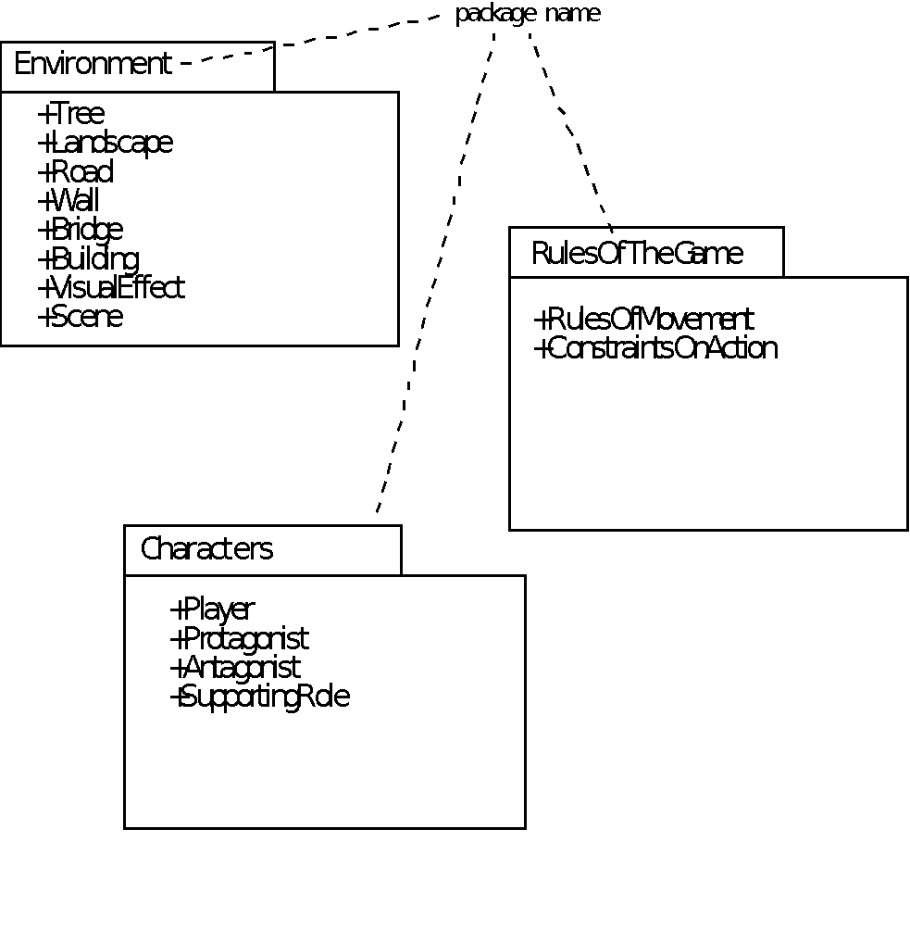
Analysis Packages

Slide 65
Behavioral Modeling
The behavioral model indicates how software will respond to external events or stimuli. To create the model, the analyst must perform the following steps:
Evaluate all use-cases to fully understand the sequence of interaction within the system.
Identify events that drive the interaction sequence and understand how these events relate to specific objects.
Create a sequence for each use-case.
Build a state diagram for the system.
Review the behavioral model to verify accuracy and consistency.

Slide 66
State Representations
In the context of behavioral modeling, two different characterizations of states must be considered:
the state of each class as the system performs its function and
the state of the system as observed from the outside as the system performs its function
The state of a class takes on both passive and active characteristics [CHA93].
A passive state is simply the current status of all of an object’s attributes.
The active state of an object indicates the current status of the object as it undergoes a continuing transformation or processing.

Slide 67
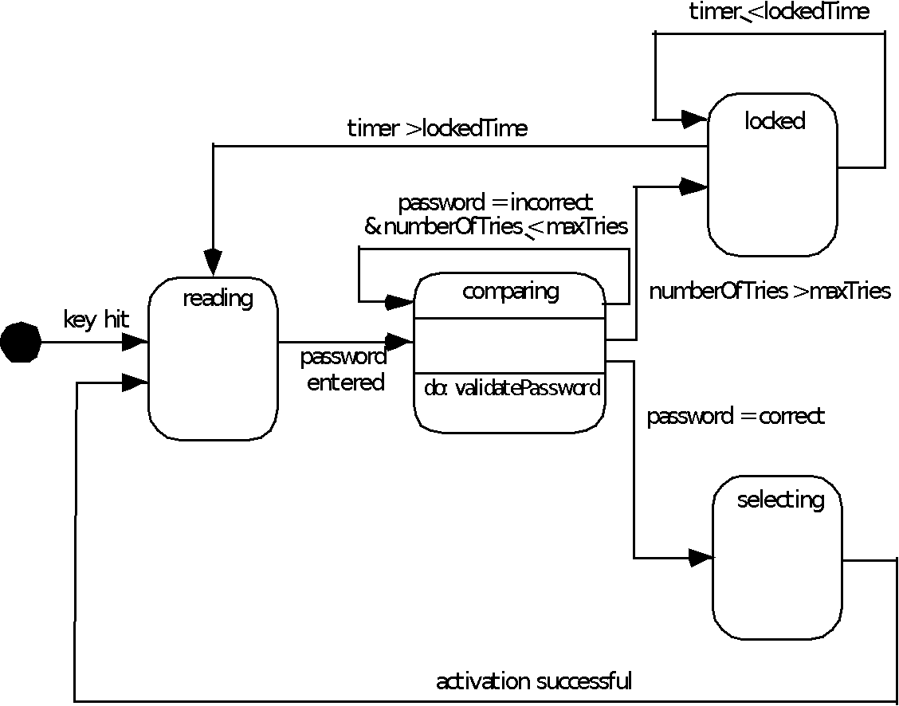
State Diagram for the ControlPanel Class

Slide 68
The States of a System
state—a set of observable circum-stances that characterizes the behavior of a system at a given time
state transition—the movement from one state to another
event—an occurrence that causes the system to exhibit some predictable form of behavior
action—process that occurs as a consequence of making a transition

Slide 69
Behavioral Modeling
make a list of the different states of a system (How does the system behave?)
indicate how the system makes a transition from one state to another (How does the system change state?)
indicate event
indicate action
draw a state diagram or a sequence diagram

Slide 70
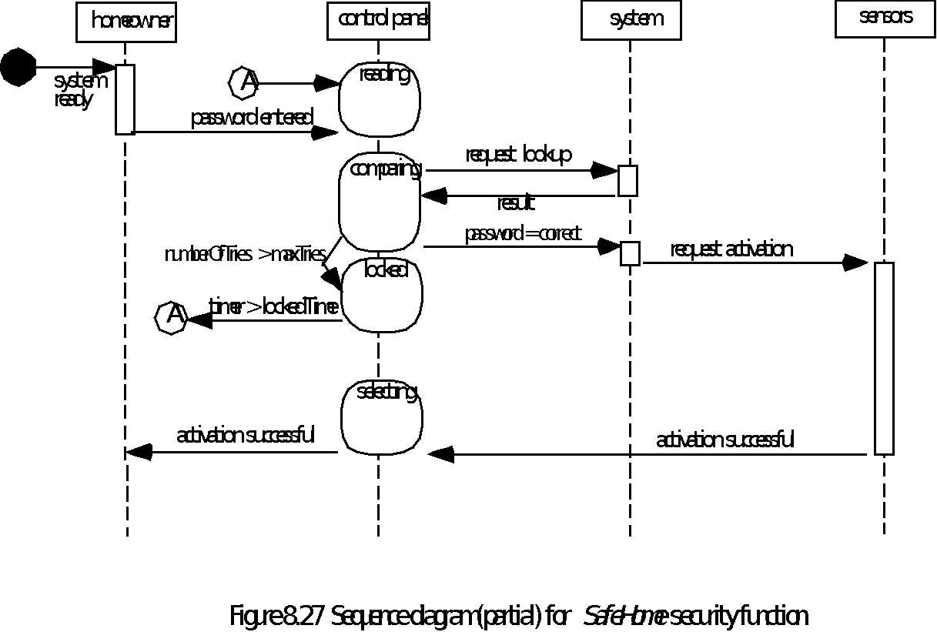
Sequence Diagram

Slide 71
Writing the Software Specification
Everyone knew exactly what had to be done until someone wrote it down!

Slide 72
Specification Guidelines

Slide 73
Specification Guidelines

Slide 74
Specification Guidelines

